Slide 1
Detox (Chat Message Toxicity Detector)
ADI1302-SPARK SCALA FUNDAMENTALS NAME : SARAVANA PRIYAN S T
REG NO : 927623BAD100

Slide 2
Problem Identification
1. Real-Time Processing & Scalability
Toxic messages can emerge at high volume in chat applications especially in gaming or streaming contexts. Systems must process messages in milliseconds and scale to handle thousands per second, without introducing latency or failing under load.
2. Context Sensitivity & Subtlety
Many messages rely on subtle language, sarcasm, or insider slang to convey toxicity. Systems must distinguish harmless banter from harmful content, which often requires understanding chat history, speaker relationships, and context nuances.
3. Bias & Fairness Concerns
Toxicity is often subjectively defined, varying with culture, identity, and language. Models trained on biased data may unfairly target certain dialects or demographic groups, necessitating careful bias analysis and mitigation strategies.

Slide 3
Tech Stack
Backend:
Python 3.13 - Core programming language
Apache Spark 3.5.3 - Distributed data processing
PySpark MLlib - Machine learning library
Flask 3.0.0 - REST API framework
Frontend:
React 18.2.0 - UI framework
Vite - Build tool
Framer Motion - Animations
Recharts - Data visualizations
Machine Learning
Logistic Regression - Classification algorithm
TF-IDF - Text vectorization (10,000 features)
Custom Lexicon - Domain-specific features (7 features)
Data
Jigsaw Dataset - 589K toxic comments
CSV Storage - Data persistence

Slide 4
Initial data source identified
DATASET NAME : jigsaw-multilingual-toxic-comment-classification
SOURCE : Kaggle
SOURCE LINK : jigsaw-dataset-kaggle-link

Slide 5
Dataset finalized and preprocessed
jigsaw-multilingual-toxic-comment-classification
Column Name | Description | Unique Values | Example
id | Unique identifier for each comment | 223,549 | 0000997932d777bf
comment_text | Raw text of the comment | 223,549 | "Explanation Why the edits made under my username Hardcore Metallica Fan were reverted?"
toxic | Binary label: 1 if toxic, else 0 | {0, 1} | 0
severe_toxic | Binary label: 1 if severely toxic, else 0 | {0, 1} | 0
obscene | Binary label: 1 if obscene, else 0 | {0, 1} | 0
threat | Binary label: 1 if threat, else 0 | {0, 1} | 0
insult | Binary label: 1 if insulting, else 0 | {0, 1} | 0
identity_hate | Binary label: 1 if hate based on identity (race, gender, etc.), else 0 | {0, 1} | 0
input_word_ids | Encoded token IDs (e.g., BERT tokenized sequence) | ~222,273 | (101, 27746, 31609, 11809, 24781, …)
input_mask | Attention mask corresponding to word IDs | ~222,273 | (1, 1, 1, 1, 1, 1, …, 0, 0, 0)

Slide 6

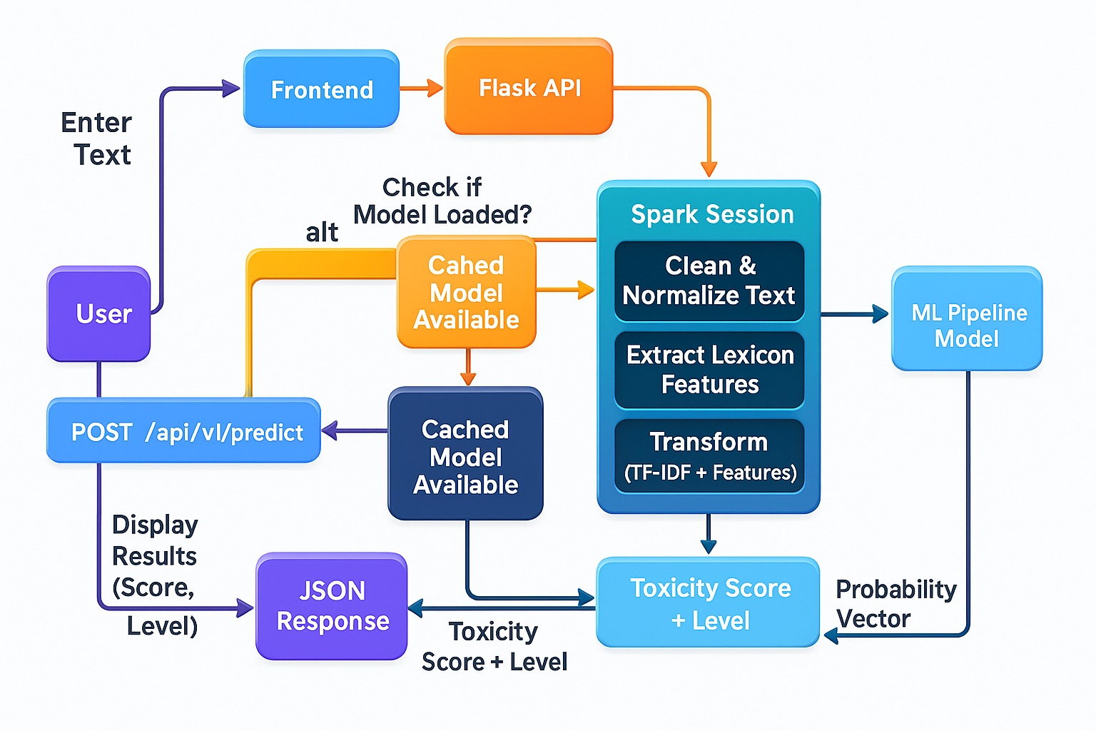
Flow Diagram

Slide 7
Modules
1. Data Preprocessing Module
Data loading, validation, and text cleaning
2. Feature Engineering Module
TF-IDF vectorization + Lexicon feature extraction
3. Model Training Module
Class balancing + Logistic Regression training
4. Prediction Module
Real-time toxicity scoring and classification
5. Production API Module
REST endpoints + Model caching + Rate limiting

Slide 8
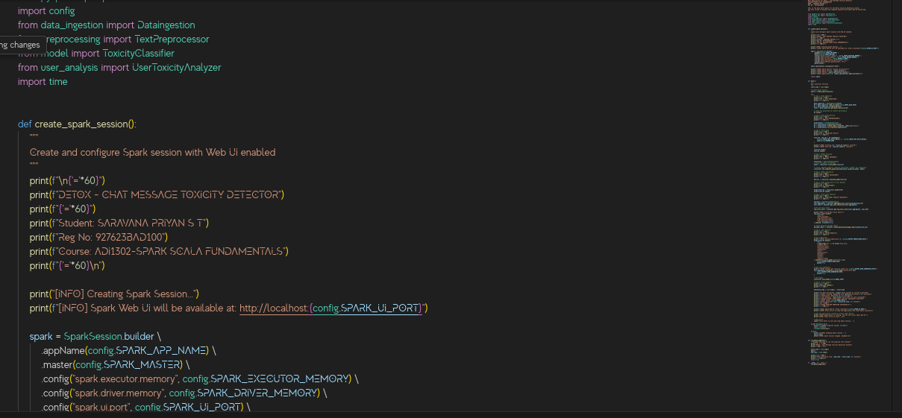
Code

Slide 9
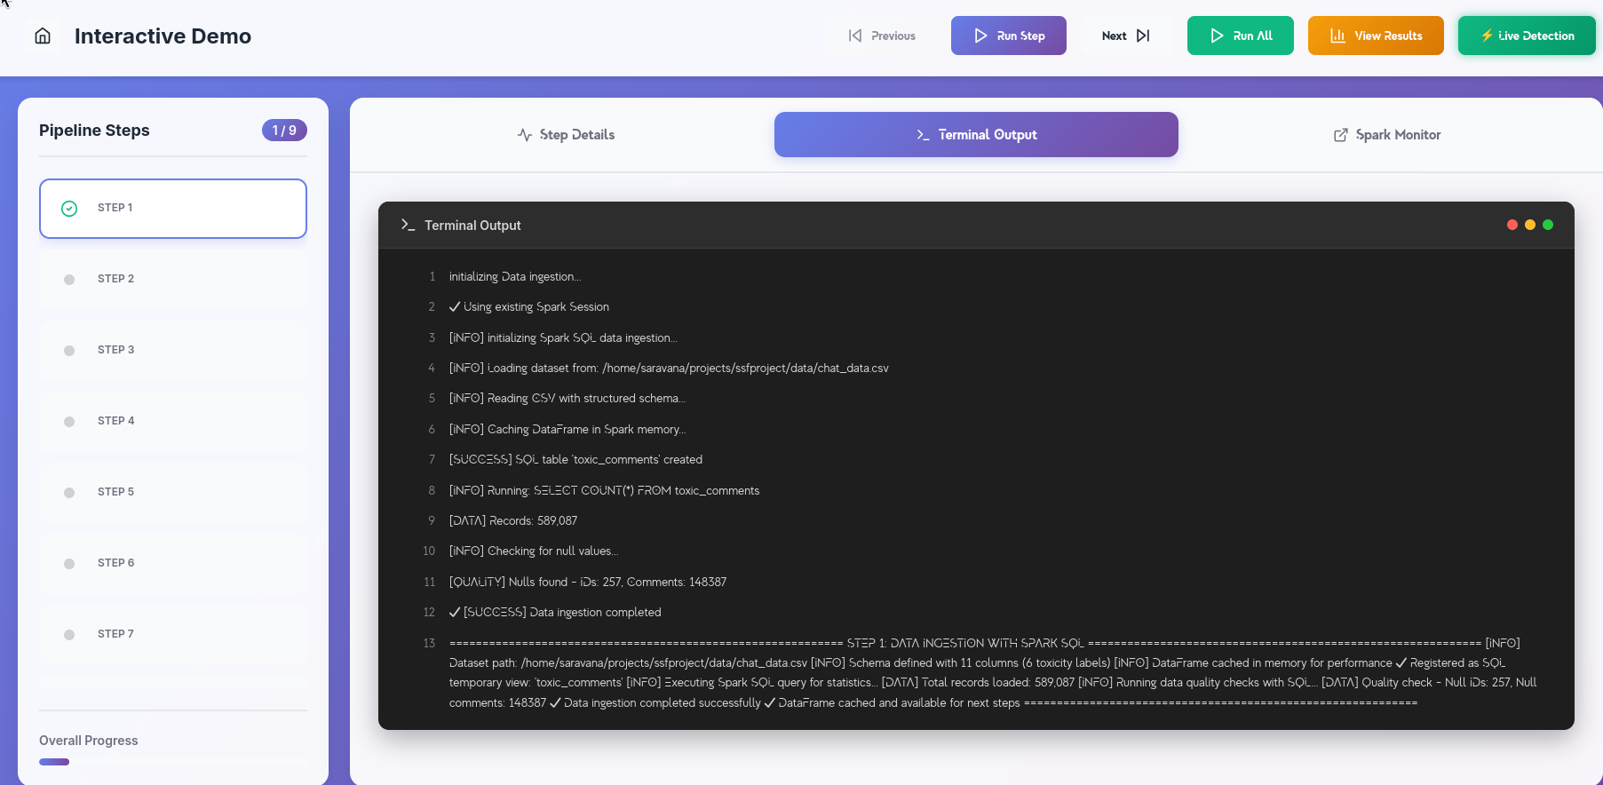
Output

Slide 10
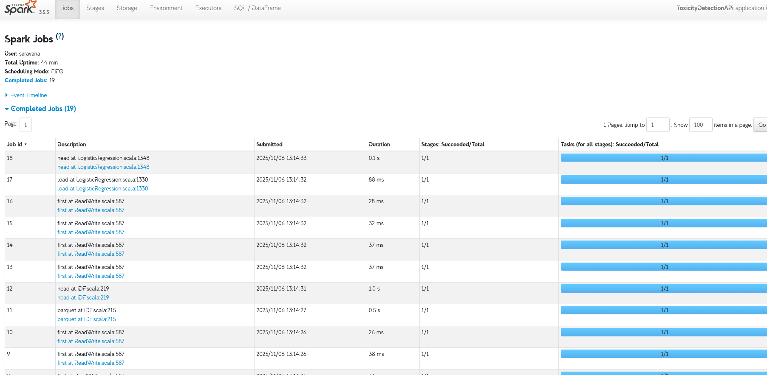
Output

Slide 11
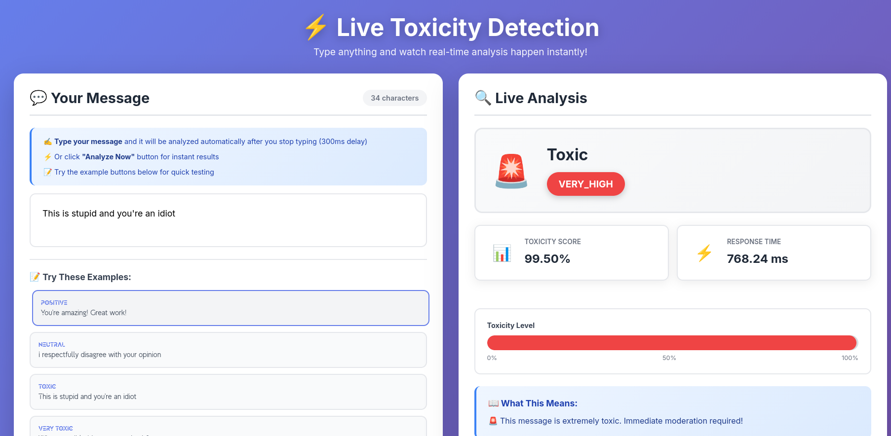
Output

Slide 12
THANK YOU

